Slide 1
Programming with C++ BCAN – E302A

Slide 2
Module – I Concepts of OOP

Slide 3
Introduction to C++ -
C++, as we all know is an extension to C language and was developed by Bjarne Stroustrup at bell labs.
C++ is an intermediate level language, as it comprises a confirmation of both high level and low level language features.
C++ is a statically typed, free form, multi-paradigm, compiled general-purpose language.
C++ is an Object Oriented Programming language but is not purely Object Oriented, due to its features like Friend and Virtual, violate some of the very important OOPS features, rendering this language unworthy of being called completely Object Oriented.

Slide 4
Benefits of C++ over C Language -
Following features of C++ makes it a stronger language than C –
There is Stronger Type Checking in C++.
All the OOPS features in C++ like Abstraction, Encapsulation, Inheritance etc makes it more worthy and useful for programmers.
C++ supports and allows user defined operators (i.e Operator Overloading) and function overloading is also supported in it.
Exception Handling is there in C++.
The Concept of Virtual functions and also Constructors and Destructors for Objects.
Inline Functions in C++ instead of Macros in C language. Inline functions make complete function body act like Macro, safely.
Variables can be declared anywhere in the program in C++, but must be declared before they are used.

Slide 5
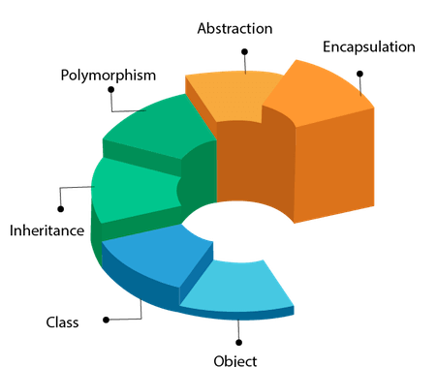
Object Oriented Programming -
Object Oriented programming is a programming style that is associated with the concept of Class, Objects and various other concepts revolving around these two, like Inheritance, Polymorphism, Abstraction, Encapsulation etc.

Slide 6
Object Oriented Programming -
Class - A class is a blueprint for any functional entity which defines its properties and its functions.
Objects - An Object is an instance of a Class. When a class is defined, no memory is allocated but when it is instantiated (i.e. an object is created) memory is allocated.
Polymorphism - When one task is performed by different ways i.e. known as polymorphism. In C++, Function overloading and Function overriding to achieve polymorphism.
Inheritance - When one object acquires all the properties and behaviors of parent object i.e. known as inheritance. It provides code reusability. It is used to achieve runtime polymorphism.
Abstraction - Hiding internal details and showing functionality is known as abstraction. In C++, we use abstract class and interface to achieve abstraction.
Encapsulation - Binding (or wrapping) code and data together into a single unit is known as encapsulation.

Slide 7
Advantages of OOP over POP language -
OOPs makes development and maintenance easier where as in Procedure-oriented programming language it is not easy to manage if code grows as project size grows.
OOPs provide data hiding whereas in Procedure-oriented programming language a global data can be accessed from anywhere.
OOPs provide ability to simulate real-world event much more effectively. We can provide the solution of real word problem if we are using the Object-Oriented Programming language.

Slide 8
Module – II Basics of C++

Slide 9
First C++ Program -
#include <iostream.h>
using namespace std;
void main()
{
cout << "Hello this is C++";
}
Header files - Header files are included at the beginning just like in C program. Here iostream is a header file which provides us with input & output streams. Header files contained predeclared function libraries, which can be used by users for their ease.
Namespace std - Using namespace std, tells the compiler to use standard namespace. Namespace collects identifiers used for class, object and variables. Namespace can be used by two ways in a program, either by the use of using statement at the beginning, like we did in above mentioned program or by using name of namespace as prefix before the identifier with scope resolution (::) operator.

Slide 10
First C++ Program -
#include <iostream.h>
using namespace std;
void main()
{
cout << "Hello this is C++";
}
Header files - Header files are included at the beginning just like in C program. Here iostream is a header file which provides us with input & output streams. Header files contained predeclared function libraries, which can be used by users for their ease.
Namespace std - Using namespace std, tells the compiler to use standard namespace. Namespace collects identifiers used for class, object and variables. Namespace can be used by two ways in a program, either by the use of using statement at the beginning, like we did in above mentioned program or by using name of namespace as prefix before the identifier with scope resolution (::) operator.

Slide 11
C++ Basic Input / Output -
C++ I/O operation is using the stream concept. Stream is the sequence of bytes or flow of data. It makes the performance fast.
If bytes flow from main memory to device like printer, display screen, or a network connection etc, this is called as output operation.
If bytes flow from device like printer, display screen, or a network connection etc to main memory, this is called as input operation.
- I/O Library Header Files –
Header File | Function and Description
<iostream> | It is used to define the cout, cin and cerr objects, which correspond to standard output stream, standard input stream and standard error stream, respectively.
<iomanip> | It is used to declare services useful for performing formatted I/O, such as setprecision and setw.
<fstream> | It is used to declare services for user-controlled file processing.

Slide 12
Standard output stream (cout) -
The cout is a predefined object of ostream class. It is connected with the standard output device, which is usually a display screen. The cout is used in conjunction with stream insertion operator (<<) to display the output on a console.
#include <iostream.h>
void main()
{
cout << "Hello this is C++";
}

Slide 13
Standard input stream (cin) -
The cin is a predefined object of istream class. It is connected with the standard input device, which is usually a keyboard. The cin is used in conjunction with stream extraction operator (>>) to read the input from a console.
#include <iostream.h>
using namespace std;
void main( )
{
int age;
cout << "Enter your age: ";
cin >> age;
cout << "Your age is: " << age << endl;
}

Slide 14
Standard end line (endl) -
The cin is a predefined object of istream class. It is connected with the standard input device, which is usually a keyboard. The cin is used in conjunction with stream extraction operator (>>) to read the input from a console.
#include <iostream.h>
using namespace std;
void main( )
{
int age;
cout << "Enter your age: ";
cin >> age;
cout << "Your age is: " << age << endl;
}

Slide 15
Escape Sequence -
Certain sequences of symbols make special meaning to the computer. They are called escape sequences
Escape Sequence starts with a backslash (\). It is actually just one special character.
Useful escape sequences –
Example –
cout<<“Hello\nWorld”
Topics | Symbols
New – Line | \n
Horizontal Tab | \t
Alert | \a
Vertical Tab | \v
Backslash | \\
Double Quote | \”

Slide 16
C++ Variable -
A variable is a name of memory location. It is used to store data. Its value can be changed and it can be reused many times. It is a way to represent memory location through symbol so that it can be easily identified.
Syntax - type variable_list;
Rules for defining variables -
A variable can have alphabets, digits and underscore.
A variable name can start with alphabet and underscore only. It can't start with digit.
No white space is allowed within variable name.
A variable name must not be any reserved word or keyword e.g. char, float etc.

Slide 17
Scope of Variables -
All the variables have their area of functioning, and out of that boundary they don't hold their value, this boundary is called scope of the variable.
We can broadly divide variables into two main types –
Global Variables
Local Variables
Global variables -
Global variables are those, which are once declared and can be used throughout the lifetime of the program by any class or any function.
They must be declared outside the main() function. If only declared, they can be assigned different values at different time in program lifetime.
But even if they are declared and initialized at the same time outside the main() function, then also they can be assigned any value at any point in the program.

Slide 18
Global Variables -
Example –
#include<iostream.h>
int x; // Global variable declared
void main()
{
x=10;
cout <<"first value of x = "<< x;
x=20;
cout <<"Initialized again with value = "<< x;
}

Slide 19
Local Variables -
Local variables are the variables which exist only between the curly braces, in which its declared. Outside that they are unavailable and leads to compile time error.
Example -
#include<iostream.h>
void main()
{
int a = 10;
if( a < 20)
{
int n=100; // Local variable declared and initialized
}
cout << n; // Compile time error, n not available here
}

Slide 20
Some special types of variable -
There are also some special keywords, to impart unique characteristics to the variables in the program.
Final - Once initialized, its value cant be changed.
Static - These variables holds their value between function calls.
Example -
#include <iostream.h>
void main()
{
final int i=10;
static int y=20;
}

Slide 21

C++ datatypes -
A data type specifies the type of data that a variable can store such as integer, floating, character etc.

Slide 22
C++ datatypes -
There are 4 types of data types in C++ language –
Types | Data Types
Basic Data Type | int, char, float, double etc.
Derived Data Type | array, pointer etc.
Enumeration Data Type | enum
User Defined Data Type | structure

Slide 23
Basic Data Types -
The basic data types are integer-based and floating-point based. C++ language supports both signed and unsigned literals. The memory size of basic data types may change according to 32 or 64 bit operating system.
Data Types | Memory Size | Range
char | 1 byte | -128 to 127
signed char | 1 byte | -128 to 127
unsigned char | 1 byte | 0 to 127
short | 2 byte | -32,768 to 32,767
signed short | 2 byte | -32,768 to 32,767
unsigned short | 2 byte | 0 to 32,767
int | 2 byte | -32,768 to 32,767
signed int | 2 byte | -32,768 to 32,767

Slide 24
Basic Data Types -
The basic data types are integer-based and floating-point based. C++ language supports both signed and unsigned literals. The memory size of basic data types may change according to 32 or 64 bit operating system.
Data Types | Memory Size | Range
unsigned int | 2 byte | 0 to 32,767
short int | 2 byte | -32,768 to 32,767
signed short int | 2 byte | -32,768 to 32,767
unsigned short int | 2 byte | 0 to 32,767
long int | 4 byte
signed long int | 4 byte
unsigned long int | 4 byte
float | 4 byte
double | 8 byte
long double | 10 byte

Slide 25
Modifiers in C++ program -
In C++, special words(called modifiers) can be used to modify the meaning of the predefined built-in data types and expand them to a much larger set.
There are four datatypes modifiers in C++, they are -
long 3. short
signed 4. unsigned
Important points -
long and short modify the maximum and minimum values that a data type will hold.
A plain int must have a minimum size of short.
Size hierarchy : short int < int < long int
Size hierarchy for floating point numbers is : float < double < long double
long float is not a legal type and there are no short floating point numbers.
Signed types includes both positive and negative numbers and is the default type.
Unsigned, numbers are always without any sign, that is always positive.

Slide 26
C++ Keywords -
A keyword is a reserved word. A list of 32 Keywords in C++ Language which are also available in C language are given below.
auto | break | case | char | const | continue | default | do
double | else | enum | extern | float | for | goto | if
int | long | register | return | short | signed | sizeof | static
struct | switch | typedef | union | unsigned | void | volatile | while

Slide 27
C++ Keywords -
A list of 30 Keywords in C++ Language which are not available in C language are given below.
asm | dynamic_cast | namespace | reinterpret_cast | bool
explicit | new | static_cast | false | catch
operator | template | friend | private | class
this | inline | public | throw | const_cast
delete | mutable | protected | true | try
typeid | typename | using | virtual | wchar_t

Slide 28
Comments in C++ Program -
For single line comments, use // before mentioning comment, like –
cout<<"single line"; // This is single line comment
For multiple line comment, enclose the comment between /* and */ -
/*this is a multiple line comment */

Slide 29
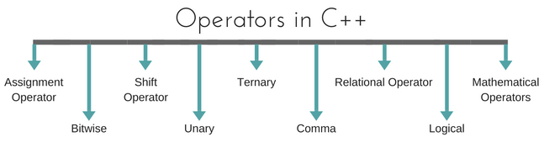
Operators -
An operator is simply a symbol that is used to perform operations. There can be many types of operations like arithmetic, logical, bitwise etc.
Types of Operators -

Slide 30
Assignment Operator (=) -
Operates '=' is used for assignment, it takes the right-hand side (called rvalue) and copy it into the left-hand side (called lvalue).
Assignment operator is the only operator which can be overloaded but cannot be inherited.
#include<iostream.h>
#include<conio.h>
int main()
{
int a = 10;
cout<<"Value of a: "<<a;
return 0;
}

Slide 31
Mathematical Operators -
There are operators used to perform basic mathematical operations. Addition (+) , subtraction (-) , diversion (/) multiplication (*) and modulus (%) are the basic mathematical operators. Modulus operator cannot be used with floating-point numbers.
C++ and C also use a shorthand notation to perform an operation and assignment at same type.
Example –
int x = 10;
x = x + 4 equivalent to x += 4
x = x – 5 equivalent to x -= 5

Slide 32
Relational Operators -
These operators establish a relationship between operands.
The relational operators are: less than (<), grater than (>), less than or equal to (<=), greater than equal to (>=), equivalent (==) and not equivalent (!=).
Difference between equal and equivalent - We must notice that assignment operator is (=) and there is a relational operator, for equivalent (==).
These two are different from each other, the assignment operator assigns the value to any variable, whereas equivalent operator is used to compare values, like in if-else conditions
Example –
int x = 10; // assignment operator
x=5; // assignment operator
if(x == 5) // relational operator
{
cout <<"Successfully compared";
}

Slide 33
Relational Operators -
These operators establish a relationship between operands.
The relational operators are: less than (<), grater than (>), less than or equal to (<=), greater than equal to (>=), equivalent (==) and not equivalent (!=).
Difference between equal and equivalent - We must notice that assignment operator is (=) and there is a relational operator, for equivalent (==).
These two are different from each other, the assignment operator assigns the value to any variable, whereas equivalent operator is used to compare values, like in if-else conditions
Example –
int x = 10; // assignment operator
x=5; // assignment operator
if(x == 5) // relational operator
{
cout <<"Successfully compared";
}

Slide 34
Logical Operators -
The logical operators are AND (&&) and OR (||).
They are used to combine two different expressions together.
If two statement are connected using AND operator, the validity of both statements will be considered, but if they are connected using OR operator, then either one of them must be valid. These operators are mostly used in loops (especially while loop) and in Decision making.
There are basically 3 types of logical operators such as –
Logical AND (&&)
Logical OR (||)
Logical NOT (!)
Example

Slide 35
Bitwise Operators -
There are used to change individual bits into a number.
They work with only integral data types like char, int and long and not with floating point values.
Bitwise AND operators (&)
Bitwise OR operator (|)
Bitwise XOR operator (^)
Bitwise NOT operator (~)
Example

Slide 36
Shift Operators -
Shift Operators are used to shift Bits of any variable. It is of three types,
Left Shift Operator (<<)
Right Shift Operator (>>)
Example

Slide 37
Unary Operators -
These are the operators which work on only one operand.
There are many unary operators, but increment ++ and decrement -- operators are most used.
Example

Slide 38
Ternary Operators -
The ternary if-else ? : is an operator which has three operands.
Example –
int a = 10;
a > 5 ? cout << "true" : cout << "false"

Slide 39
Comma Operators -
This is used to separate variable names and to separate expressions. In case of expressions, the value of last expression is produced and used.
Example –
int a,b,c; // variables declaration using comma operator
a=b++, c++; // a = c++ will be done.

Slide 40
sizeOf Operators in C++ -
sizeOf() is also an operator not a function, it is used to get information about the amount of memory allocated for data types & Objects.
It can be used to get size of user defined data types too.
sizeOf() operator can be used with and without parentheses. If you apply it to a variable you can use it without parentheses.
Example –
cout << sizeOf(double); //Will print size of double
int x = 2;
int a = sizeOf x;

Slide 41
typedef Operators in C++ -
typedef is a keyword used in C language to assign alternative names to existing types.
Its mostly used with user defined data types, when names of data types get slightly complicated.
Following is the general syntax for using typedef, it can be used to get size of user defined data types too.
Syntax - typedef existing_name alias_name;
Example - typedef unsigned long ulong;
ulong i, j;

Slide 42
Control Statement in C++ -
In C++ programming, if statement is used to test the condition. There are various types of if statements in C++.
Simple If Statement - The C++ if statement tests the condition. It is executed if condition is true.
Syntax -
if(condition)
{
//code to be executed
}
Simple if statement | Nested if-else statement
if-else statement | if-else-if ladder

Slide 43
Source Code of Simple - if statement -
#include<iostream.h>
#include<conio.h>
void main ()
{
int num = 10;
if (num % 2 == 0)
{
cout<<"It is even number";
}
}

Slide 44
If-else Statement -
The C++ if-else statement also tests the condition. It executes if block if condition is true otherwise else block is executed.
Syntax –
if(condition)
{
//code if condition is true
}
else
{
//code if condition is false
}

Slide 45
Source Code of if-else statement -
#include<iostream.h>
#include<conio.h>
void main ()
{
int num = 10;
if (num % 2 == 0) {
cout<<"It is even number";
}
else {
cout<<"It is odd number";
}
}

Slide 46
Nested if-else Statement -
A nested if is an if statement that is the target of another if statement. Nested if statements means an if statement inside another if statement.
Syntax –
if (condition1)
{
// Executes when condition1 is true
if (condition2) {
// Executes when condition2 is true
}
else {
// Executes when condition2 is false
}
}

Slide 47
Source Code of if-else statement -
#include<iostream.h>
#include<conio.h>
void main()
{
int i = 10;
if (i == 10) {
if (i < 15) {
cout<<"i is smaller than 15";
}
if (i < 12) {
cout<<"i is smaller than 12 too";
}
else {
cout<<"i is greater than 15";
}
}
}

Slide 48
if-else-if ladder Statement -
Syntax –
if (condition) {
//statement;
}
else if (condition) {
//statement;
}
.
.
.
else {
//statement;
}

Slide 49
Source Code of if-else-if ladder statement -
#include<iostream.h>
#include<conio.h>
void main()
{
int i = 20;
if (i == 10)
cout<<"i is 10";
else if (i == 15)
cout<<"i is 15";
else if (i == 20)
cout<<"i is 20";
else
cout<<"i is not present";
}

Slide 50
Switch Case Statement -
The C++ switch statement executes one statement from multiple conditions. It is like if-else-if ladder statement in C++.
Syntax –
switch(expression)
{
case value1: //code to be executed; break;
case value2: //code to be executed; break;
......
default: //if all cases are not matched; break;
}

Slide 51
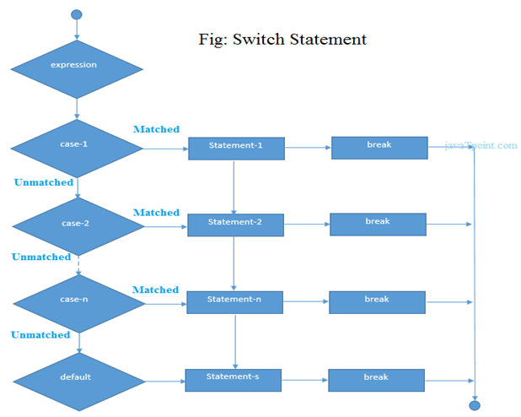

Slide 52
Example –
#include<iostream.h>
#include<conio.h>
void main ()
{
int num;
cout<<"Enter a number to check grade:";
cin>>num;
switch (num)
{
case 10: cout<<"It is 10"; break;
case 20: cout<<"It is 20"; break;
case 30: cout<<"It is 30"; break;
default: cout<<"Not 10, 20 or 30"; break;
}
}

Slide 53
For Loop -
The C++ for loop is used to iterate a part of the program several times. If the number of iteration is fixed, it is recommended to use for loop than while or do-while loops.
The C++ for loop is same as C. We can initialize variable, check condition and increment/decrement value.
Syntax –
for(initialization; condition; incr/decr)
{
//code to be executed
}

Slide 54
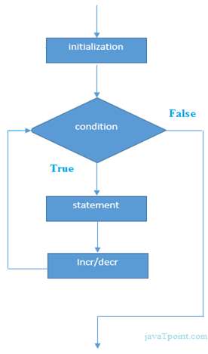
Example –
#include<iostream.h>
#include<conio.h>
void main()
{
int i;
for(i=1;i<=10;i++)
{
cout<<i <<"\n";
}
}

Slide 55
While Loop -
C++ while loops statement allows to repeatedly run the same block of code until a condition is met.
while loop is a most basic loop in C++. while loop has one control condition, and executes as long the condition is true.
The condition of the loop is tested before the body of the loop is executed, hence it is called an entry-controlled loop.
Syntax –
while (condition)
{
statement(s);
Incrementation;
}

Slide 56
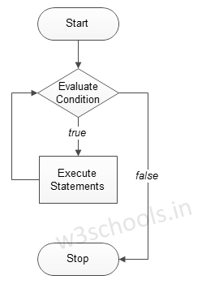
Example –
#include<iostream.h>
#include<conio.h>
void main()
{
int i=1;
while(i<=10)
{
cout << “\t”<<i;
i++;
}
}

Slide 57
Do-while Loop -
C++ do while loops are very similar to the while loops, but it always executes the code block at least once and furthermore as long as the condition remains true.
This is an exit-controlled loop.
Syntax –
do
{
statement(s);
increamentation;
}while( condition );

Slide 58
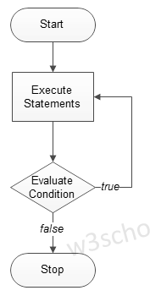
Example –
#include<iostream.h>
#include<conio.h>
void main()
{
int i=1;
do{
cout << “\t” <<i;
i++;
} while(i<=10);
}

Slide 59
User defined functions -
In programming, function refers to a segment that groups code to perform a specific task. Depending on whether a function is predefined or created by programmer; there are two types of function:
Library Function
User-defined Function
Library Function – Library functions are the built-in function in C++ programming. Programmer can use library function by invoking function directly; they don't need to write it themselves.
User defined Function - C++ allows programmer to define their own function. A user-defined function groups code to perform a specific task and that group of code is given a name(identifier). When the function is invoked from any part of program, it all executes the codes defined in the body of function.

Slide 60
Example 1: Library Function -
#include<iostream.h>
#include<cmath.h>
void main()
{
double number, squareRoot;
cout << "Enter a number: ";
cin >> number;
squareRoot = sqrt(number);
cout << "Square root of " << number << " = " << squareRoot;
}

Slide 61
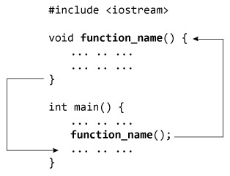
How user-defined function works in C Programming?

Slide 62
Example 2: User Defined Function -
#include<iostream.h>
// Function prototype (declaration)
int add(int, int);
void main()
{
int num1, num2, sum;
cout<<"Enters two numbers to add: ";
cin >> num1 >> num2;
// Function call
sum = add(num1, num2);
cout << "Sum = " << sum;
}
// Function definition
int add(int a, int b)
{
int add;
add = a + b;
// Return statement
return add;
}

Slide 63
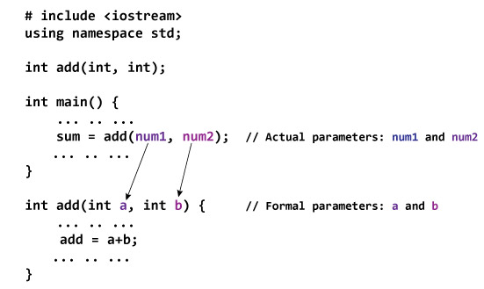
Passing Arguments to Function -

Slide 64
Different types of user defined functions -
With out return type, with out parameters
With out return type, with parameters
With return type, with out parameters
With return type, with parameters

Slide 65
With out return type, with out parameters -
#include<iostream.h>
#include<conio.h>
void add();
void main()
{
clrscr();
add();
getch();
}
void add()
{
int a,b,c=0;
cout<<“Enter the numbers: ”;
cin>>a>>b;
c = (a + b);
cout<<“Sum is: ”<<c;
}

Slide 66
With out return type, with parameters -
#include<iostream.h>
#include<conio.h>
void add(int a, int b);
void main()
{
int p,q;
cout<<“Enter numbers: ”;
cin>>p>>q;
add(p,q);
}
void add(int a, int b)
{
c = (a + b);
cout<<“Sum is: ”<<c;
}

Slide 67
With return type, with out parameters -
#include<iostream.h>
#include<conio.h>
int add();
void main()
{
int p;
cout<<“Enter numbers: ”;
cin>>p;
p = add();
cout<<“Sum is: ”<<c;
}
int add()
{
int a,b,c;
cout<<“Enter numbers: ”;
cin>>a>>b;
c = (a + b);
return c;
}

Slide 68
With return type, with parameters -
#include<iostream.h>
#include<conio.h>
int add(int a, int b);
void main()
{
int p, q, sum = 0;
cout<<“Enter numbers: ”;
cin>>p>>q;
sum = add(p,q);
cout<<“Sum is: ”<<c;
}
int add(int a, int b)
{
c = (a + b);
return c;
}

Slide 69
Default Arguments -
One of the most useful facilities in C++, to define default arguments for function.
In the function prototype declaration, default arguments are given.
#include<iostream> #include<conio.h> void sum(int a, int b=10); void main() { int p; cout<<"Enter the number: "; cin>>p; sum(p); } | void sum(int x, int y) { int z = (x + y); cout<<"Sum is: "<<z; }

Slide 70
Class -
The building block of C++ that leads to Object Oriented programming is a Class. It is a user defined data type, which holds its own data members and member functions, which can be accessed and used by creating an instance of that class.
A class is like a blueprint for an object.
Each and every class has two specific properties –
Member Variables
Member Functions
There are 2 ways to define a member function:
Type – I: Inside class definition
Type – II: Outside class definition

Slide 71
Object -
An Object is an instance of a Class. When a class is defined, no memory is allocated but when it is instantiated (i.e. an object is created) memory is allocated.
Declaring Objects - When a class is defined, only the specification for the object is defined; no memory or storage is allocated. To use the data and access functions defined in the class, you need to create objects.
Syntax: ClassName ObjectName;

Slide 72
How to define Class & Object – (Type – I)
#include<iostream.h>
#include<conio.h>
class Sample {
private:
int a,b,c;
public:
void calc()
{
cout << “Enter numbers: ”;
cin>>a>>b;
c = (a + b);
cout << “Sum is: ”<<c;
}
};
void main()
{
Sample obj;
clrscr();
obj.calc() ;
getch();
}

Slide 73
How to define Class & Object – (Type – II)
#include<iostream.h>
#include<conio.h>
class Sample {
private:
int a,b,c;
public:
void calc();
};
void Sample :: calc() {
cout << “Enter numbers: ”;
cin>>a>>b;
c = (a + b);
cout << “Sum is: ”<<c;
}
void main()
{
Sample obj;
clrscr();
obj.calc() ;
getch();
}
Note: :: is known as Scope Resolution Operator.

Slide 74
Constructor -
In C++, constructor is a special method which is invoked automatically at the time of object creation. It is used to initialize the data members of new object generally.
The constructor in C++ has the same name as class or structure.
There can be two types of constructors in C++.
Default constructor
Parameterized constructor
Default Constructor - A constructor which has no argument is known as default constructor. It is invoked at the time of creating object.
Parameterized Constructor - A constructor which has parameters is called parameterized constructor. It is used to provide different values to distinct objects.

Slide 75
Example of Default Constructor -
#include<iostream.h>
#include<conio.h>
class Defal
{
public:
int x;
int y;
Defal()
{
x=0;
y=0;
}
};
void main()
{
Defal obj;
cout << “Default constructor”;
cout << obj.x ;
cout << obj.y ;
}

Slide 76
Example of Parameterized Constructor -
#include<iostream.h>
#include<conio.h>
class PrCons
{
public:
int x,y,z;
PrCons(int a, int b)
{
x = a;
y = b;
}
};
void main()
{
PrCons obj(10,20);
cout<<"\nValue of a: "<<obj.x;
cout<<"\nValue of b: "<<obj.y;
}

Slide 77
Example of Parameterized Constructor – (Type – II)
#include<iostream.h>
#include<conio.h>
class Rectangle
{
int width, height;
public:
Rectangle (int,int);
int area () {
return (width*height);
}
};
Rectangle::Rectangle (int a, int b) {
width = a;
height = b;
}
void main()
{
Rectangle rect (3,4);
Rectangle rectb (5,6);
cout<<“rect area: “<<rect.area();
cout<<“rectb area: “<<rectb.area() ;
}

Slide 78
Destructor -
A destructor is used to destroy the objects that have been created by a constructor.
Like constructor, the destructor is a member function whose name is the same as the class name but is preceded by a tilde.
A destructor never takes any argument nor does it return any value.
It will be invoked implicitly by the compiler upon exit from the program – or block or function as the case may be – to clean up storage that is no longer accessible.
It is a good practice to declare destructors in a program since it releases memory space for further use.
Note - C++ destructor cannot have parameters. Moreover, modifiers can't be applied on destructors.

Slide 79
Example of Destructor -
#include<iostream.h>
#include<conio.h>
class Destruct
{
public:
Destruct()
{
cout<<"Constructor Invoked"<<endl;
}
~Destruct()
{
cout<<"Destructor Invoked"<<endl;
}
};
void main()
{
Destruct e1;
}

Slide 80
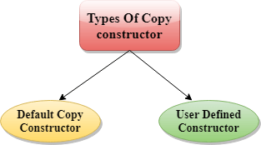
C++ Copy Constructor –
A Copy constructor is an overloaded constructor used to declare and initialize an object from another object.
Copy Constructor is of two types -
Default Copy constructor - The compiler defines the default copy constructor. If the user defines no copy constructor, compiler supplies its constructor.
User Defined constructor - The programmer defines the user-defined constructor.

Slide 81
Explanation of Copy Constructor -
A copy constructor is used to declare and initialize an object from another object.
The process of initializing through a copy constructor is known as copy initialization.
A reference variable has been used as an argument to the copy constructor.
We cannot pass the argument by value to a copy constructor.
The copy constructors are used in the following situations –
>> The initialization of an object by another object of the same class.
>> Return of objects as a function value.
>> Starting the object as by value parameters of a function.

Slide 82
Example of Copy Constructor -
#include<iostream.h>
#include<conio.h>
class Example{
int a, b;
public:
Example(int x, int y){
a = x;b = y;
}
Example(const Example& obj){
a = obj.a;b = obj.b;
}
void Display(){
cout << "\nValues :" << a << "\t" << b;
}
};
void main()
{
//Normal Constructor Invoked
Example Object(10, 20);
//Copy Constructor Invoked - Method 1
Example Object2(Object);
//Copy Constructor Invoked - Method 2
Example Object3 = Object;
Object.Display();
Object2.Display();
Object3.Display();
}

Slide 83
Multiple Constructors in a class -
C++ permits to use more than one constructors in a single class -
MultConstructors(); //No arguments
MultConstructors(int x, int y); // Two arguments

Slide 84
#include<iostream>
#include<conio.h>
class MultConstructors
{
public:
int a,b,c;
MultConstructors()
{
c = 0;
}
MultConstructors(int x, int y)
{
a = x;
b = y;
}
};
void main()
{
MultConstructors mDObj;
cout<<"Value is: "<<mDObj.a<<"\t"<<mDObj.b;
MultConstructors mPObj(1,2);
cout<<"\nValue is: "<<mPObj.a<<"\t"<<mPObj.b;
c = (a + b);
cout<<“Sum is: ”<<c;
}

Slide 85
Constructor with Default Arguments -
It is possible to define constructors with default arguments.
#include<iostream.h>
#include<conio.h>
class Sample
{
private:
int a, b, c;
public:
Sample(int x = 10, int y = 20){
a = x;
b = y;
}
void show(){
cout<<“value is: ”<<a;
cout<<“value is: ”<<b;
}
};

Slide 86
C++ static –
In C++, static is a keyword or modifier that belongs to the type not instance. So instance is not required to access the static members.
In C++, static can be field, method, constructor, class, properties, operator and event.
Advantages –
Memory efficient - Now we don't need to create instance for accessing the static members, so it saves memory. Moreover, it belongs to the type, so it will not get memory each time when instance is created.
Static Variables - Variables in a function, Variables in a class.
Static Field – A field which is declared as static is called static field. Unlike instance field which gets memory each time whenever you create object, there is only one copy of static field created in the memory. It is shared to all the objects.

Slide 87
Static variables in a function –
When a variable is declared as static, space for it gets allocated for the lifetime of the program. Even if the function is called multiple times, space for the static variable is allocated only once and the value of variable in the previous call gets carried through the next function call.
#include<iostream.h>
#include<string>
void demo()
{
static int count = 0;
cout << count << " ";
count++;
}
void main()
{
for (int i=0; i<5; i++)
{
demo();
}
}

Slide 88
Static variables in a class –
As the variables declared as static are initialized only once as they are allocated space in separate static storage so, the static variables in a class are shared by the objects. There can not be multiple copies of same static variables for different objects. Also because of this reason static variables can not be initialized using constructors.
#include<iostream.h>
#include<conio.h>
class GfG
{
public:
static int i;
GfG()
{
//i = 0;
}
};
int GfG :: i = 999;
int main()
{
GfG obj1;
cout<<obj1.i<<endl;
GfG obj2;
obj1.i =2;
obj2.i = 3;
cout << obj1.i<<" "<<obj2.i;
return 0;
}

Slide 89
Static Members of Class –
Class objects as static - Just like variables, objects also when declared as static have a scope till the lifetime of program.
#include<iostream.h>
#include<conio.h>
class GfG
{
int i = 0;
public:
GfG()
{
i = 0;
cout << "Inside Constructor\n";
}
~GfG()
{
cout << "Inside Destructor\n";
}
};
void main()
{
int x = 0;
if (x==0)
{
static GfG obj;
}
cout << "End of main\n";
}

Slide 90
Static functions in a class -
Just like the static data members or static variables inside the class, static member functions also does not depend on object of class. We are allowed to invoke a static member function using the object and the ‘.’ operator but it is recommended to invoke the static members using the class name and the scope resolution operator. Static member functions are allowed to access only the static data members or other static member functions, they can not access the non-static data members or member functions of the class.
#include<iostream.h>
#include<conio.h>
class GGI
{
public:
static void printMsg()
{
cout<<"Welcome to GGI…";
}
};
void main()
{
GfG::printMsg();
}

Slide 91
Structure in C++ -
C++ Structure is a collection of different data types. It is similar to the class that holds different types of data.
Syntax - struct structure_name
{
// member declarations.
}
Example - struct Student
{
char name[20];
int id;
int age;
}
How to create the instance of Structure? - Structure variable can be defined as - Student s;
How to access the variable of Structure? - The variable of the structure can be accessed by simply using the instance of the structure followed by the dot (.) operator and then the field of the structure. For example - s.id = 4;

Slide 92
#include<iostream.h>
#include<conio.h>
struct Rectangle
{
int width, height;
};
void main()
{
struct Rectangle rec;
rec.width=8;
rec.height=5;
cout<<"Area of Rectangle is: "<<(rec.width * rec.height);
}

Slide 93
#include<iostream.h>
#include<conio.h>
struct Rectangle
{
int width, height;
Rectangle(int w, int h)
{
width = w;
height = h;
}
void areaOfRectangle()
{
cout<<"Area of Rectangle is: "<<(width*height);
}
};
void main()
{
struct Rectangle rec=Rectangle(4,6);
rec.areaOfRectangle();
}

Slide 94
Instance Variables –
Instance variables are non-static variables and are declared in a class outside any method, constructor or block. As instance variables are declared in a class, these variables are created when an object of the class is created and destroyed when the object is destroyed.
Unlike local variables, we may use access specifiers for instance variables. If we do not specify any access specifier then the default access specifier will be used.
Initialization of Instance Variable is not Mandatory.
Instance Variable can be accessed only by creating objects.

Slide 95
#include<iostream.h>
#include<conio.h>
class Marks
{
public:
static int studentNumber;
int engMarks;
int mathsMarks;
int phyMarks;
public:
Marks()
{
++studentNumber;
};
};
int Marks::studentNumber = 0;
void main()
{
Marks obj1;
obj1.engMarks = 50;
obj1.mathsMarks = 80;
obj1.phyMarks = 90;
cout << Marks::studentNumber << endl;
cout << obj1.engMarks << endl;
cout << obj1.mathsMarks << endl;
cout << obj1.phyMarks << endl;
}

Slide 96
this pointer –
In C++ programming, this is a keyword that refers to the current instance of the class. There can be 3 main usage of this keyword in C++.
It can be used to pass current object as a parameter to another method.
It can be used to refer current class instance variable.
It can be used to declare indexers.
#include<iostream.h>
#include<conio.h>
class Employee
{
public:
int id;
string name;
float salary;
Employee(int id, string name, float salary)
{
this->id = id;
this->name = name;
this->salary = salary;
}
void display()
{
cout<<id<<" "<<name<<" "<<salary<<endl;
}
};

Slide 97
void main()
{
Employee e1 =Employee(101, "Sonoo", 890000);
Employee e2=Employee(102, "Nakul", 59000);
e1.display();
e2.display();
}

Slide 98
Exception Handling –
Exception Handling in C++ is a process to handle runtime errors. We perform exception handling so the normal flow of the application can be maintained even after runtime errors.
In C++, exception is an event or object which is thrown at runtime.
All exceptions are derived from std::exception class. It is a runtime error which can be handled. If we don't handle the exception, it prints exception message and terminates the program.
Advantage - It maintains the normal flow of the application. In such case, rest of the code is executed even after exception.

Slide 99
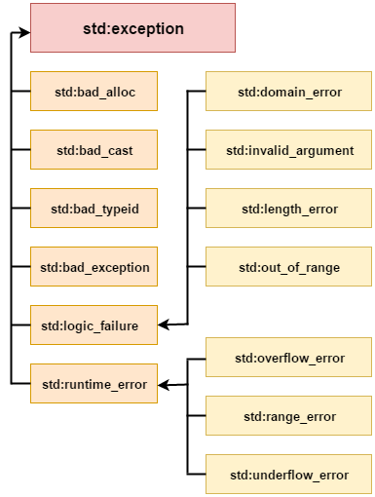
Exception Classes -
In C++ standard exceptions are defined in <exception> class that we can use inside our programs. The arrangement of parent-child class hierarchy is shown below –

Slide 100
Exception | Description
std::exception | It is an exception and parent class of all standard C++ exceptions.
std::logic_failure | It is an exception that can be detected by reading a code.
std::runtime_error | It is an exception that cannot be detected by reading a code.
std::bad_exception | It is used to handle the unexpected exceptions in a c++ program.
std::bad_cast | This exception is generally be thrown by dynamic_cast.
std::bad_typeid | This exception is generally be thrown by typeid.
std::bad_alloc | This exception is generally be thrown by new.
NOTE: In C++, we use 3 keywords to perform exception handling -
try
catch
throw

Slide 101
Try/catch Example -
#include<iostream.h>
#include<conio.h>
float division(int x, int y)
{
if( y == 0 )
{
throw "Attempted to divide by zero!";
}
return (x/y);
}
void main ()
{
int i = 25;
int j = 0;
float k = 0;
try
{
k = division(i, j);
cout << k << endl;
}
catch (const char* e)
{
cerr << e << endl;
}
}

Slide 102
Friend Function -
If a function is defined as a friend function in C++, then the protected and private data of a class can be accessed using the function.
By using the keyword friend compiler knows the given function is a friend function.
For accessing the data, the declaration of a friend function should be done inside the body of a class starting with the keyword friend.
Declaration of friend function in C++ -
class class_name
{
friend data_type function_name(argument/s);
};
NOTE - In the above declaration, the friend function is preceded by the keyword friend. The function can be defined anywhere in the program like a normal C++ function. The function definition does not use either the keyword friend or scope resolution operator.

Slide 103

Characteristics of a Friend Function -
The function is not in the scope of the class to which it has been declared as a friend.
It cannot be called using the object as it is not in the scope of that class.
It can be invoked like a normal function without using the object.
It cannot access the member names directly and has to use an object name and dot membership operator with the member name.
It can be declared either in the private or the public part.

Slide 104
#include<iostream.h>
#include<conio.h>
class Box
{
private:
int length;
public:
Box()
{
length = 0;
}
friend int printLength(Box);
};
int printLength(Box b)
{
b.length += 10;
return b.length;
}
void main()
{
Box b;
cout<<"Length of box: "<< printLength(b)<<endl;
}
Example of Friend Function

Slide 105
A friend class can access both private and protected members of the class in which it has been declared as friend.
#include<iostream.h>
#include<conio.h>
class A
{
int x =5;
friend class B;
};
class B
{
public:
void display(A &a)
{
cout<<"value of x is : "<<a.x;
}
};
int main()
{
A a;
B b;
b.display(a);
return 0;
}
Example of Friend Class

Slide 106
Inline Function –
What is inline function?
The inline functions are a C++ enhancement feature to increase the execution time of a program.
Functions can be instructed to compiler to make them inline so that compiler can replace those function definition wherever those are being called.
Compiler replaces the definition of inline functions at compile time instead of referring function definition at runtime.
If function is big (in term of executable instruction etc) then, compiler can ignore the “inline” request and treat the function as normal function.

Slide 107
How to make function inline?
To make any function as inline, start its definitions with the keyword “inline”.
Syntax -
inline int add(int a, int b)
{
return (a + b);
};
Advantages –
It speeds up your program by avoiding function calling overhead.
It save overhead of variables push/pop on the stack, when function calling happens.
It save overhead of return call from a function.
It increases locality of reference by utilizing instruction cache.
By marking it as inline, you can put a function definition in a header file (i.e. it can be included in multiple compilation unit, without the linker complaining)

Slide 108
Disadvantages –
It increases the executable size due to code expansion.
C++ inlining is resolved at compile time. Which means if you change the code of the inline function, you would need to recompile all the code using it to make sure it will be updated
When used in a header, it makes your header file larger with information which users don’t care.
As mentioned above it increases the executable size, which may cause thrashing in memory. More number of page fault bringing down your program performance.
Sometimes not useful for example in embedded system where large executable size is not preferred at all due to memory constraints.

Slide 109
#include<iostream.h>
#include<conio.h>
inline int sqr(int x)
{
int y;
y = x * x;
return y;
}
int main()
{
int a =3, b;
b = sqr(a);
cout <<"ans is "<<b;
return 0;
}
Example of Inline Function

Slide 110
C++ Inheritance –
In C++, inheritance is a process in which one object acquires all the properties and behaviors of its parent object automatically. In such way, we can reuse, extend or modify the attributes and behaviors which are defined in other class.
In C++, the class which inherits the members of another class is called derived class and the class whose members are inherited is called base class. The derived class is the specialized class for the base class.
Advantages -
Code reusability - Now we can reuse the members of your parent class. So, there is no need to define the member again. So less code is required in the class.
Types Of Inheritance -
Single inheritance
Multiple inheritance
Hierarchical inheritance
Multilevel inheritance
Hybrid inheritance

Slide 111
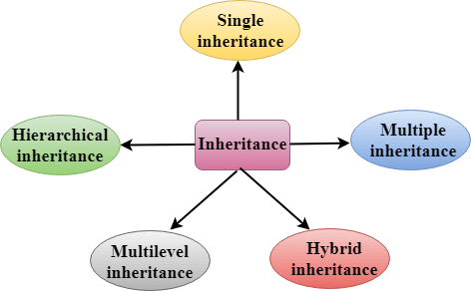

Slide 112
Derived Classes - A Derived class is defined as the class derived from the base class.
Syntax - class derived_class_name :: visibility-mode base_class_name
{
// body of the derived class.
}
where -
derived_class_name - It is the name of the derived class.
visibility mode - The visibility mode specifies whether the features of the base class are publicly inherited or privately inherited. It can be public or private.
base_class_name - It is the name of the base class.
When the base class is privately inherited by the derived class, public members of the base class becomes the private members of the derived class. Therefore, the public members of the base class are not accessible by the objects of the derived class only by the member functions of the derived class.
When the base class is publicly inherited by the derived class, public members of the base class also become the public members of the derived class. Therefore, the public members of the base class are accessible by the objects of the derived class as well as by the member functions of the base class.

Slide 113

Note -
In C++, the default mode of visibility is private.
The private members of the base class are never inherited.
Single Inheritance -
Single inheritance is defined as the inheritance in which a derived class is inherited from the only one base class.

Slide 114
Single Level Inheritance Example: Inheriting Fields -
#include<iostream.h>
#include<conio.h>
class Account
{
public:
float salary = 60000;
};
class Programmer: public Account
{
public:
float bonus = 5000;
};
void main()
{
Programmer p1;
cout<<"Salary: "<<p1.salary<<endl;
cout<<"Bonus: "<<p1.bonus<<endl;
}

Slide 115
Single Level Inheritance Example: Inheriting Methods -
#include<iostream.h>
#include<conio.h>
class Animal
{
public:
void eat()
{
cout<<"Eating..."<<endl;
}
};
class Dog: public Animal
{
public:
void bark()
{
cout<<"Barking...";
}
};
void main()
{
Dog d1;
d1.eat();
d1.bark();
}

Slide 116
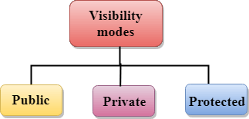
How to make a Private Member Inheritable –
The private member is not inheritable. If we modify the visibility mode by making it public, but this takes away the advantage of data hiding.
C++ introduces a third visibility modifier, i.e., protected. The member which is declared as protected will be accessible to all the member functions within the class as well as the class immediately derived from it.
Visibility modes can be classified into three categories -
Public - When the member is declared as public, it is accessible to all the functions of the program.
Private - When the member is declared as private, it is accessible within the class only.
Protected - When the member is declared as protected, it is accessible within its own class as well as the class immediately derived from it.

Slide 117
Visibility of Inherited Members -
Base class visibility | Derived class visibility
 | Public | Private | Protected
Private | Not Inherited | Not Inherited | Not Inherited
Protected | Protected | Private | Protected
Public | Public | Private | Protected

Slide 118

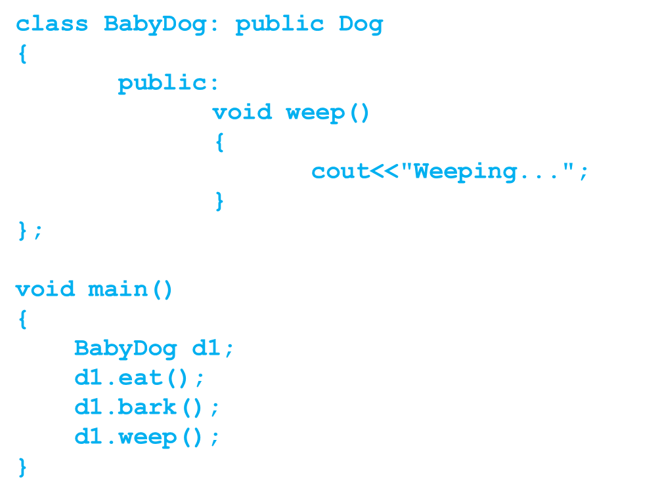
Multilevel Inheritance - Multilevel inheritance is a process of deriving a class from another derived class.
#include<iostream.h>
#include<conio.h>
class Animal
{
public:
void eat()
{
cout<<"Eating..."<<endl;
}
};
class Dog: public Animal
{
public:
void bark()
{
cout<<"Barking..."<<endl;
}
};

Slide 119
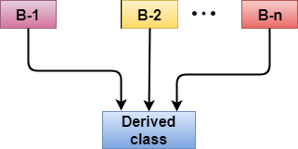
Multiple Inheritance -
Multiple inheritance is the process of deriving a new class that inherits the attributes from two or more classes.
Ambiguity Resolution in Inheritance –
Ambiguity can be occurred in using the multiple inheritance when a function with the same name occurs in more than one base class.
Note: Example of Multiple Inheritance and Ambiguity Resolution discussed later.

Slide 120
#include<iostream.h>
#include<conio.h>
class A
{
protected:
int a;
public:
void get_a(int n)
{
a = n;
}
};
class B
{
protected:
int b;
public:
void get_b(int n)
{
b = n;
}
};
class C : public A, public B
{
public:
void display()
{
cout << "The value of a is : " << a;
cout << "The value of b is : " << b;
cout << "Addition of a and b is : “ << (a+b);
}
};
void main()
{
C c;
c.get_a(10);
c.get_b(20);
c.display();
}
Example of Multiple Inheritance

Slide 121
#include<iostream.h>
#include<conio.h>
class A
{
public:
void display()
{
cout << "Class A" << endl;
}
};
class B
{
public:
void display()
{
cout << "Class B" << endl;
}
};
class C : public A, public B
{
void view()
{
A :: display();
B :: display();
}
};
void main()
{
C c;
c.display();
}
Example of Ambiguity Resolution

Slide 122
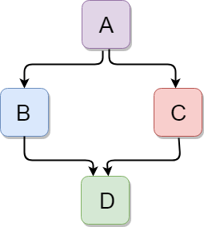
Hybrid Inheritance -
Hybrid inheritance is a combination of more than one type of inheritance.
#include<iostream.h>
#include<conio.h>
class A
{
protected:
int a;
public:
void get_a()
{
cout << "Enter the value of 'a' : " << endl;
cin>>a;
}
};

Slide 123
class B : public A
{
protected:
int b;
public:
void get_b()
{
cout << "Enter the value of 'b' : " << endl;
cin>>b;
}
};
class C
{
protected:
int c;
public:
void get_c()
{
cout << "Enter the value of c is : " << endl;
cin>>c;
}
};

Slide 124
class D : public B, public C
{
protected:
int d;
public:
void mul()
{
get_a();
get_b();
get_c();
cout << "Multiplication of a,b,c is : " <<a*b*c<< endl;
}
};
void main()
{
D d;
d.mul();
}

